Slide 1
Microsoft Power Platform
Notes:
Hi, Welcome to Microsoft Power Platform

Slide 2
Course Overview
Day 1 – Part I
Empowering Everyone with Power Platform – From CEO to Frontline Workers
Introduction to Power Platform
Day 1 – Part II
Power Packed Day with Power Canvas Apps
Introduction to Power Apps
Day 2 – Part I
Power Packed Day with Power Model Driven Apps
Let’s talk about data
Day 2 – Part II
Power Packed Day with Power Automate
Introduction
Day 3 – Part I
Power Packed Day with Power Agents
Introduction
Microsoft Power Platform momentum
Why Power Platform?
Customer Stories
Demo
Benefits of Power Apps
What can I build with Power Apps?
Types of Power Apps
Canvas Apps
Data Sources and Connectors
Demo
Types of Data
Dataverse
Model-driven Apps
What type of components can I add?
Data model design
Demo
Types of flow
Data types and expression
Working with Arrays
Control flow and action settings
Demo
A Robust Virtual Agent Platform
Converse everywhere
Easily make your bots better
Create personalized customer experiences
Transfer to a human agent
Built on Power Platform & Azure Bot Service
Extend your bot capabilities with Azure Bot Service
Demo

Slide 3
Continue…
Day 3 – Part II
Power Packed Day with Power BI
Introduction
Day 4 – Part I
Power up your Apps with AI Builder
Introduction
Day 4 – Part II
Power Platform Administration, Security & Integration Connectors
Introduction
Day 5 – Part I
Power Platform integration with SharePoint
Introduction
Day 5 – Part II
Power Platform integration with MS Teams
Introducing Dataverse for Teams
AI for every app. And everyone
Setup Environment
Types of AI Model
Prediction
Form processing
Object detection
Text classification
Demo
The 5x5 Principle
Customer momentum: Power BI
Power BI Desktop
Data sources
Power Query
Dataflow
Using a Calculation (DAX) in multiple files
Paginated Reporting
Power BI Admin Portal
Demo
Secure your tenant
Monitor your tenant’s activity
Alert & act on that activity
Connectors
SharePoint Integration
Demo
Modify SharePoint list forms with Power Apps
Make Power Apps a MS Teams App
Integrate Power Automate with MS Teams
Integrate Power Virtual Agents with MS Teams
Use case: Leave Management Application
Demo
Build Approvals in SharePoint with Power Automate
Use case: Manage Project Lifecycle
Demo

Slide 4
Day 5: Power Packed Day with SharePoint

Slide 5

Agenda
SharePoint + Power Platform
Integrate Power BI reports in SharePoint
SharePoint + Power Apps
Extend SharePoint list with Power Apps
SharePoint approvals with Power Automate
Demo
Build Leave Approval System with SharePoint and Power Platform
Notes:
https://docs.microsoft.com/en-us/powerapps/maker/canvas-apps/sharepoint-scenario-intro
https://docs.microsoft.com/en-us/powerapps/maker/canvas-apps/customize-list-form

Slide 6


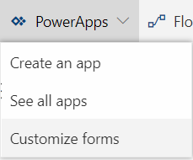


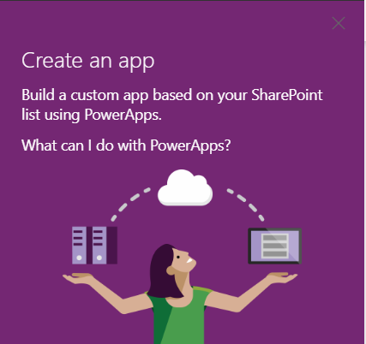

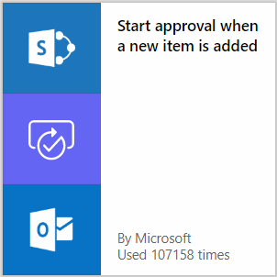

Customize SharePoint forms
SharePoint lists as a data source for PowerApps
Approval workflow in SharePoint (and many more)

Slide 7

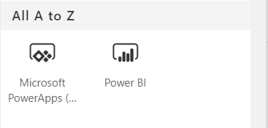


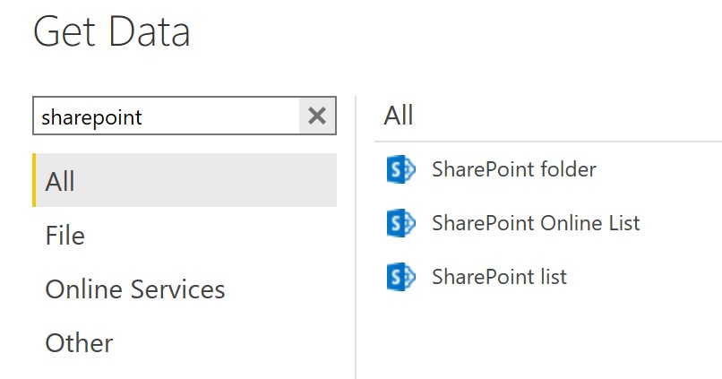

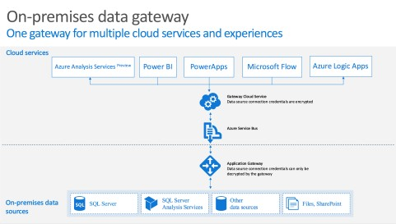

SharePoint webparts
SharePoint as a data source for Power BI
SharePoint on-premises via data gateway
https://docs.microsoft.com/en-us/powerapps/maker/canvas-apps/gateway-reference

Slide 8

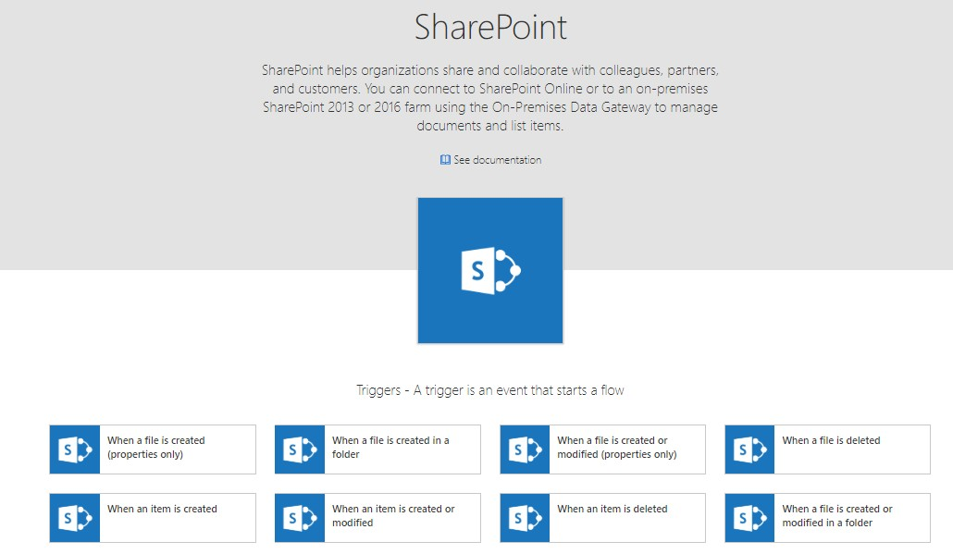

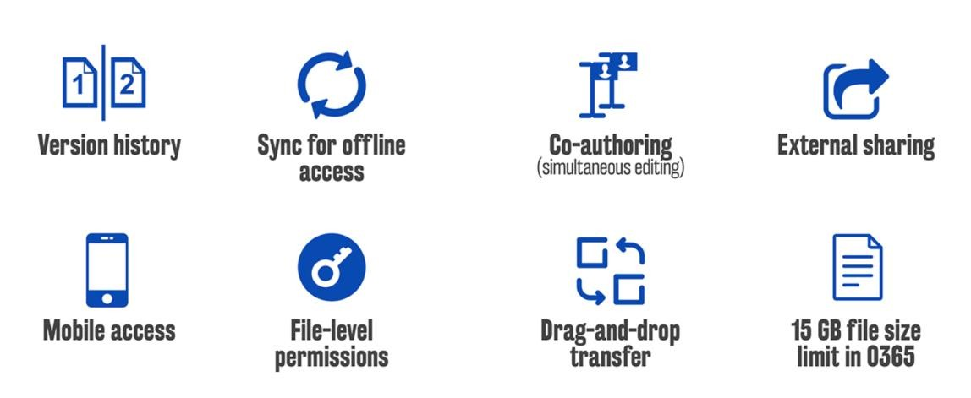
A ubiquitous data storage in Office 365
Key features for SharePoint and OneDrive

Slide 9
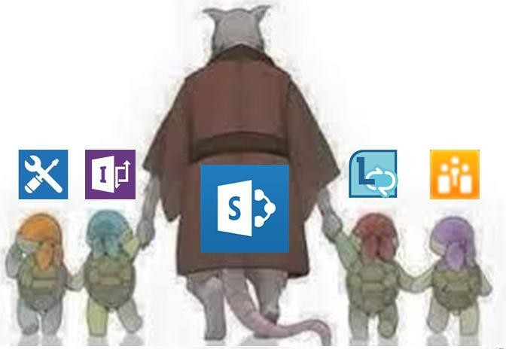
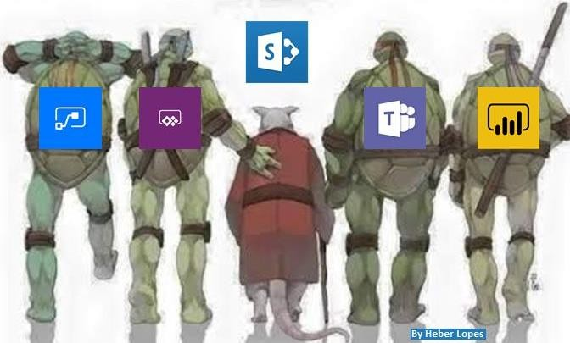
@HeberOLopes

Slide 10
Customize a SharePoint list or library form
Notes:
https://docs.microsoft.com/en-us/powerapps/maker/canvas-apps/customize-list-form

Slide 11
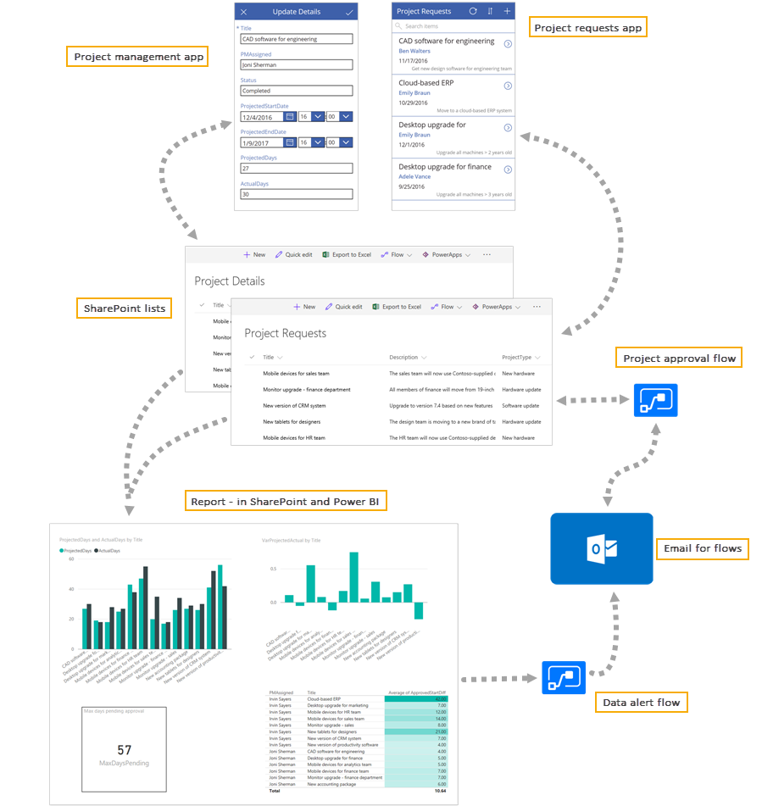
SharePoint + Power Platform

Slide 12
Set up lists in SharePoint
Notes:
https://docs.microsoft.com/en-us/powerapps/maker/canvas-apps/sharepoint-scenario-setup

Slide 13
Generate a canvas app to handle project requests
Notes:
https://docs.microsoft.com/en-us/powerapps/maker/canvas-apps/sharepoint-scenario-setup

Slide 14
Create a flow to manage project approvals
Notes:
https://docs.microsoft.com/en-us/powerapps/maker/canvas-apps/sharepoint-scenario-setup

Slide 15
Create a canvas app to manage projects
Notes:
https://docs.microsoft.com/en-us/powerapps/maker/canvas-apps/sharepoint-scenario-build-app

Slide 16
Create a Power BI report
Notes:
https://docs.microsoft.com/en-us/powerapps/maker/canvas-apps/sharepoint-scenario-build-report

Slide 17
Publish the Power BI report
Notes:
https://docs.microsoft.com/en-us/powerapps/maker/canvas-apps/sharepoint-scenario-publish-report

Slide 18
Embed the Power BI report in SharePoint Online
Notes:
https://docs.microsoft.com/en-us/powerapps/maker/canvas-apps/sharepoint-scenario-embed-report

Slide 19
Continue… Part 2

